Slide 1
Algorithmic Trading
Machine Learning

Slide 2
Submitted By:
Satyam Singh(201500625)
Akshat Maan Singh(201500067)
Supra Vyas(201500718)
Akhil Jaiswal(201500063)
Submitted To:
Ms. Ruchi Talwar

Slide 3
Content
Introduction
Problem Statement
Objective
Technology Used
What is Stock Market
What is Algorithmic Trading
K-Nearest Neighbor
Linear Regression
Library Used
Implementation

Slide 4
Introduction
Algorithmic trading, also known as algo-trading, is a result of the growing capabilities of computers
Algorithmic trading refers to trading strategies that are automated, both in terms of identifying and executing trades. The increased use of automated trading systems fits into the general trend toward automation in most industries. However, algorithmic trading is more than just a more efficient way to enter orders. The entire research and trading process can benefit from automation, computing power and new fields like artificial intelligence.

Slide 5
Problem Statement
Nowadays people are more interest in stock market as people started learning about that and the interest of the people are growing rapidly. But for the newcomers they don’t have much knowledge about the shares or some does not have a time to gain the knowledge of stock or trading due to which people get huge loss as they don’t know about the outcome.

Slide 6
Objective
Stock Price Prediction using machine learning helps you discover the future value of company stock and other financial assets traded on an exchange.
The entire idea of predicting stock prices is to gain significant profits.
Predicting how the stock market will perform is a hard task to do.

Slide 7
Technology Used
HARDWARE:
4 GB RAM
20 GB Storage
CPU : 2 Ghz or faster
SOFTWARE
Python 3 (Google Colab)
Windows or MAC OS

Slide 8
What is Stock Market?
The term stock market refers to several exchanges in which shares of publicly held companies are bought and sold. Such financial activities are conducted through formal exchanges and via over-the-counter (OTC) marketplaces that operate under a defined set of regulations.
Both “stock market” and “stock exchange” are often used interchangeably. Traders in the stock market buy or sell shares on one or more of the stock exchanges that are part of the overall stock market.

Slide 9


Slide 10
What is Algorithmic Trading
Algorithmic trading strategies follow a rule-based system to select trading instruments, identify trading opportunities, manage risk and optimize position size and capital use. In most cases systems are automated so that entries and exits are executed by the algorithm too. The terms systematic trading, electronic trading, black-box trading, mechanical trading, and quantitative trading can at times be used interchangeably with algorithmic trading.

Slide 11
K-Nearest Neighbor Algorithm
Supervised Machine Learning
Non- parametric Algorithm
Also known as Lazy Learner
Can be used for regression and Classifier

Slide 12
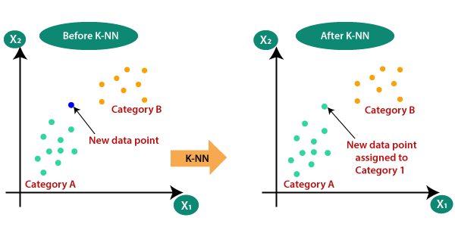

Slide 13
Why K-NN?
The k-nearest neighbors (KNN) algorithm is a simple, easy-to-implement supervised machine learning algorithm that can be used to solve both classification and regression problems.
When should you use KNN?
KNN-classifier can be used when your data set is small enough, so that KNN-Classifier completes running in a shorter time. The complexity for applying a Naive bayes model is o(1) So, even though KNN works best for your data, when you know your data size will keep increasing it’s wise to choose Naive Bayes.
Where is KNN used?
Despite its simplicity, KNN can outperform more powerful classifiers and is used in a variety of applications such as economic forecasting, data compression and genetics. For example, KNN was leveraged in a 2006 study of functional genomics for the assignment of genes based on their expression profiles.

Slide 14
Linear Regression
Supervised Machine Learning
Used for solving Regression problems
Shows the relationship between dependent and independent variables
Statistical Method used for predictive analysis
Make prediction for continuous/real or numeric variables
Two types of Linear Relationship
Positive Linear Relationship
Negative Linear Relationship

Slide 15
Assumption of Linear Regression
Linear Relationship between the feature and the target
Small or no multicollinearity between the features
Homoscedasticity Assumption
Normal Distribution of error terms
No AutoCorrelation

Slide 16
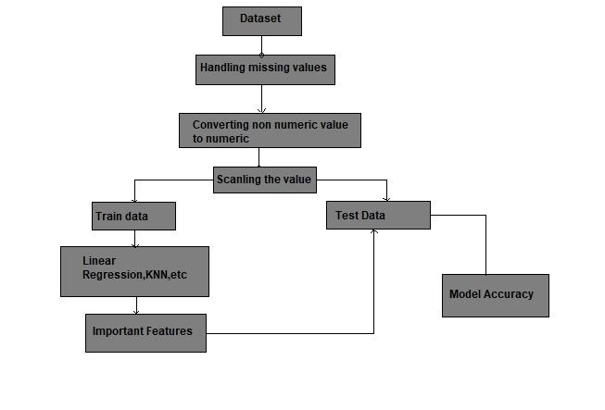
Flowchart Of Algorithm

Slide 17
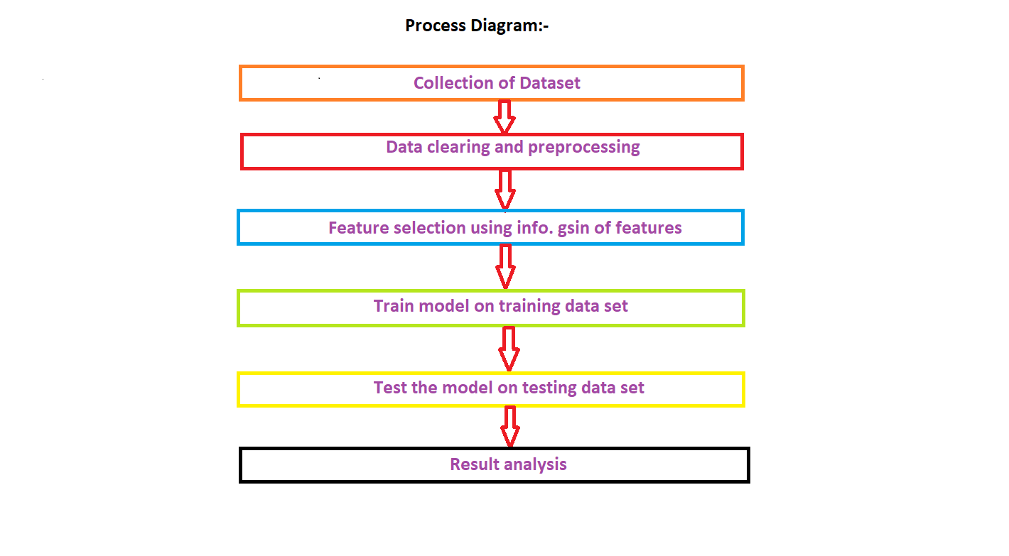

Slide 18
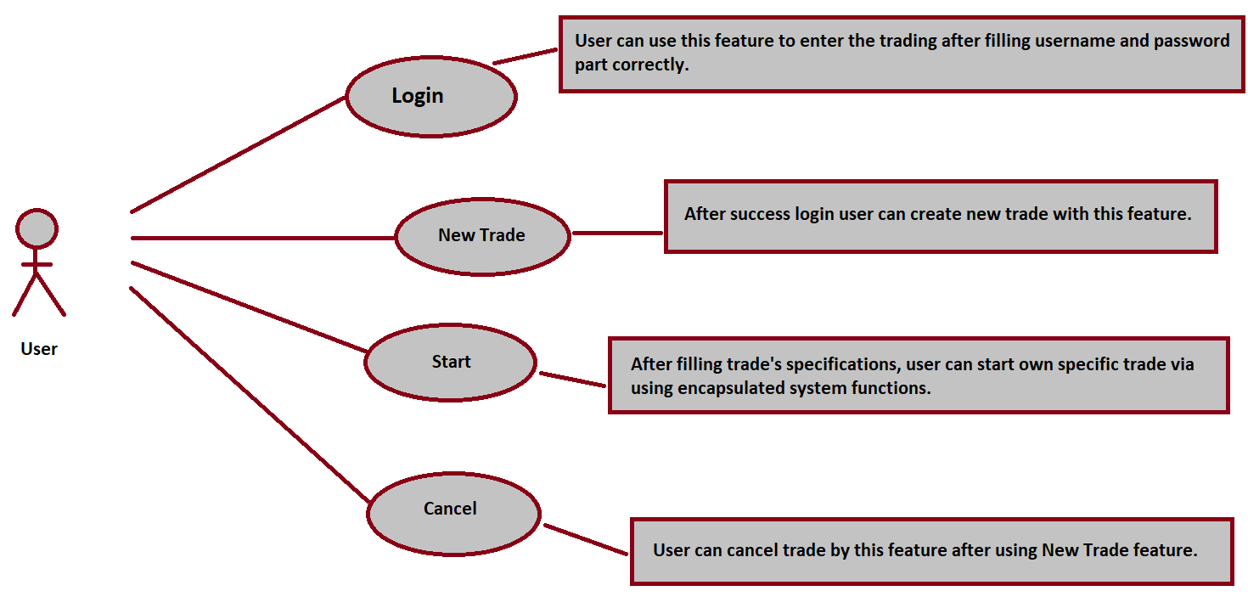

Slide 19
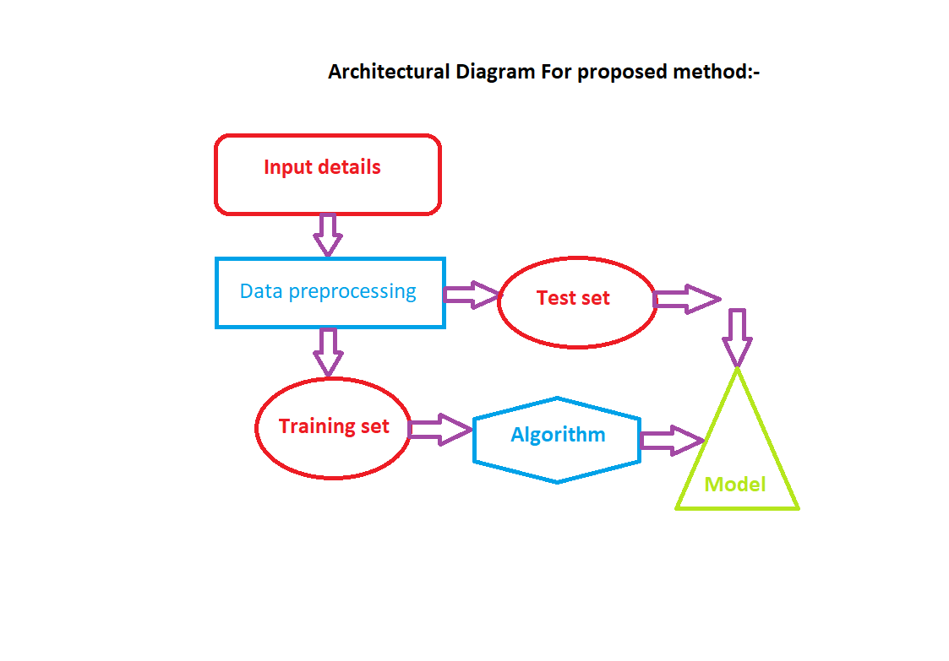

Slide 20


Slide 21
Library Used
Numpy:Used for working with arrays.It has a function of working with linear algebra ,fourier transformation and matrix. It works for the numerical data .We import the library in the python by import as
Import numpy as np
Pandas:Pandas is used for the tabular data.It has a powerful tools like Data Frames and Series that are mainly used for analyzing the data. It is used for the multidimensional array. We import the library in the python by import as:-
Import pandas as pd

Slide 22
3.matplotlib: It serves as a visualization utility. It is used for creating static animated and interactive visualization in python. Make things easy things easy and hard things possible.Maake interactive figures that can zoom,pan
Update. We import the library in python as :
Import matplotlib.pyplot as plt
4.sklearn: It contains alot of efficient tools of machine learning and statistical modelling including classification,regression,clustering and dimensionality reduction. We import the library by the :
from sklearn.neighbors import KNeighborsClassifier

Slide 23
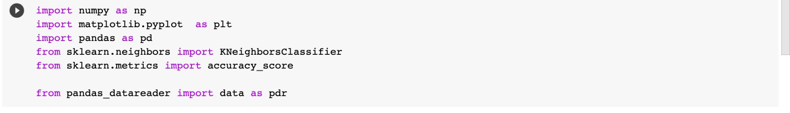
Implementation
First we will import the libraries which is necessary for the implementation of the project . We had import the numpy and pandas library for the numerical and tabular data. Then we import the matplotlib.pyplot library for plotting the graph.Then we imported the KNeighborsClassifier from sklearn.neighbors and accuracy score from sklearn.metrics

Slide 24
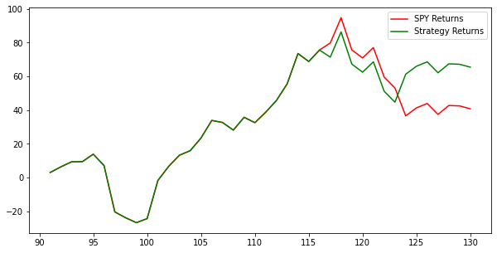

Slide 25
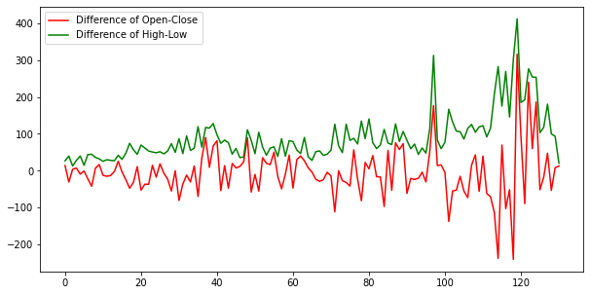

Slide 26
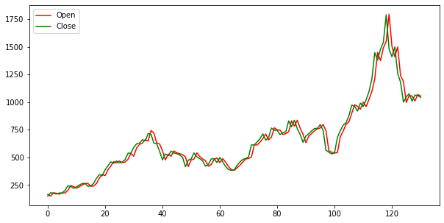

Slide 27
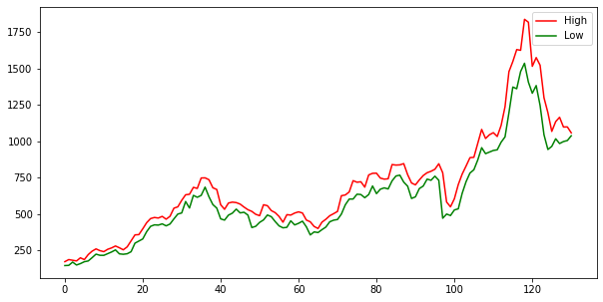

Slide 28
Conclusion
According to this research paper prediction accuracy is sweet for datasets.
This research paper can find out that the company’s stock price would increase or decrease and the accuracy is very good.

